Slide 1






JavaScript
Team Cymbidium Orchid
Teamwork Project
http://meandmy.softuni-friends.org/NakMan/
Software University

Slide 2
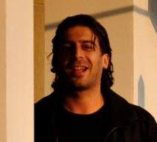
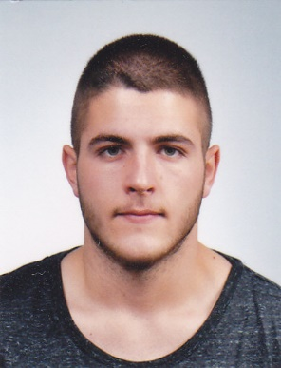
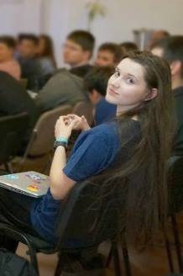
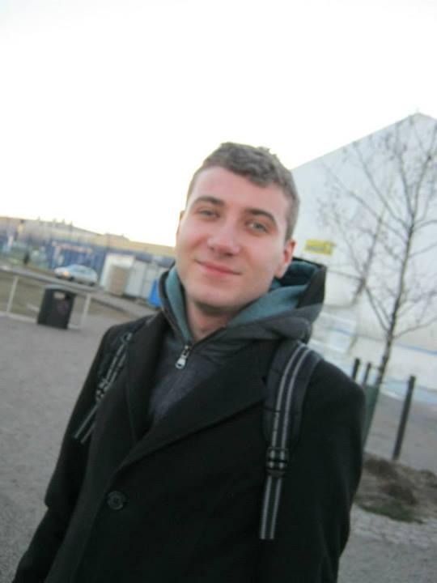
Team Cymbidium Orchid
Georgi Inkov
Daniel
Petrovaliev
Yulia
Tenincheva
Ivan
Yonkov

Slide 3
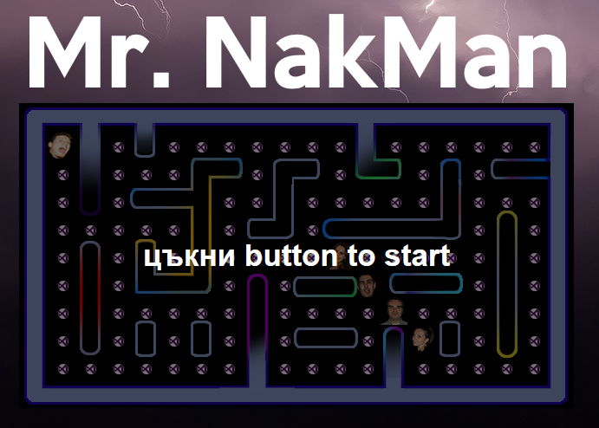

http://meandmy.softuni-friends.org/NakMan/
Demo…
Demo…
https://github.com/CymbidiumOrchid/NakMan

